Slide 1


Multi-site & Multi-year conditional simulation and prediction of streamflow extremes: Identification of low frequency hydroclimatic variability in the Ohio River Basin
Yash Amonkar, Upmanu Lall
Columbia Water Center, Department of Earth and Environmental Engineering, Columbia University

Slide 2
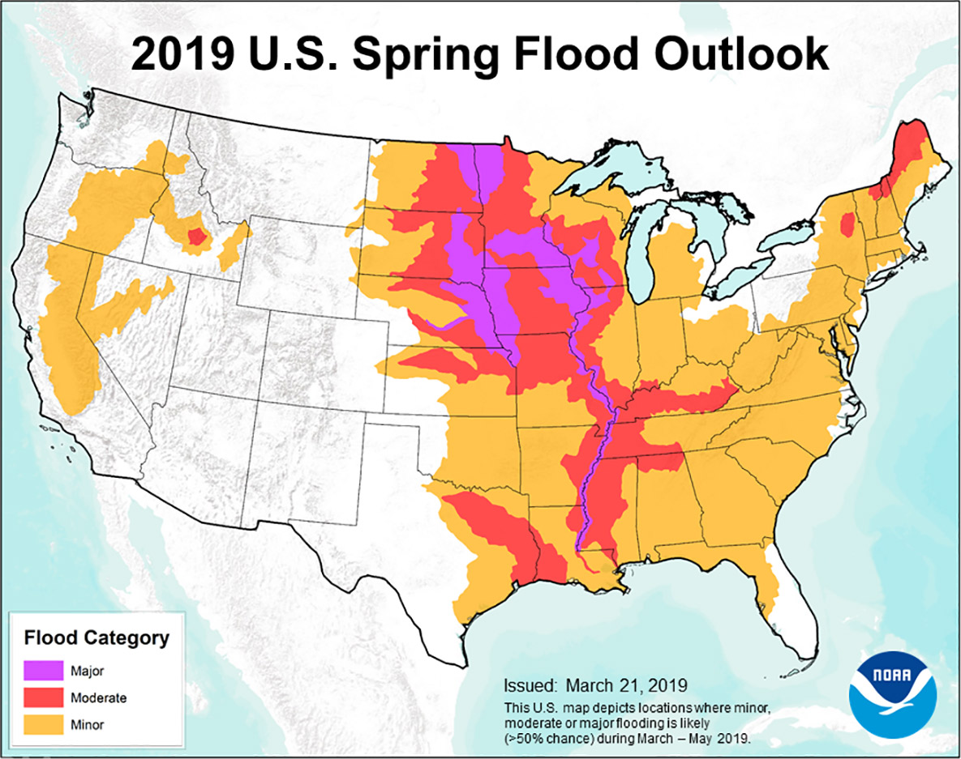
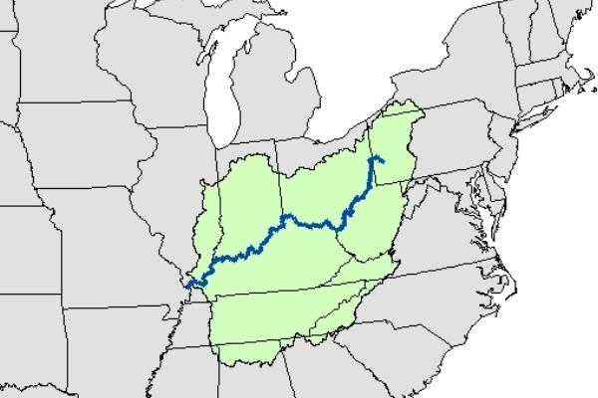
Introduction
This has been the wettest 12 months in the history of United States since 1895¹, and the longest flood duration since 1927 on the Mississippi.
The Ohio River Basin and upper Mississippi has a long history of large-scale regional flooding in 1882,1913,1937,1997 and most recently in 2011.
The flooding in this basin is dominated by the precipitation and snow melt².
Figure : 2019 U.S Spring Flood Outlook. Credit - NOAA
1. NOAA – National Temperature and Precipitation Maps. 2. Nakamura, J., Lall, U., Kushnir, Y., Robertson, A. W., & Seager, R. (2013). Dynamical structure of extreme floods in the US Midwest and the United Kingdom. Journal of Hydrometeorology, 14(2), 485-504. 2. Farnham, D. J., Doss‐Gollin, J., & Lall, U. (2018). Regional Extreme Precipitation Events: Robust Inference From Credibly Simulated GCM Variables. Water Resources Research, 54(6), 3809-3824.3. Robertson, Andrew W., et al. "Weather and climatic drivers of extreme flooding events over the midwest of the United States." Extreme Events: Observations, Modeling, and Economics (2015): 113-124.
Figure : Ohio River Basin. Credit - Orsanco

Slide 3
Objectives and Research Questions
Objective: To understand the climatic context of multi-year hydroclimatic dynamics that determine extreme floods, and their potential multi-year prediction to guide near term climate risk mitigation and adaptation
Research Question: Is there identifiable, recurrent, regime structure across years, in the incidence of extreme spring floods in the Ohio River Basin?
If yes:
What are the characteristic time scales of recurrence, and the associated spatial pattern?
Is there a statistical model that can capture and simulate these low frequency dynamics?
Do typical climate indices correlate with and provide a measure of predictability for these extreme flood patterns?
How well can one predict these space-time patterns for the next 1, 2, 3, …. Years?

Slide 4
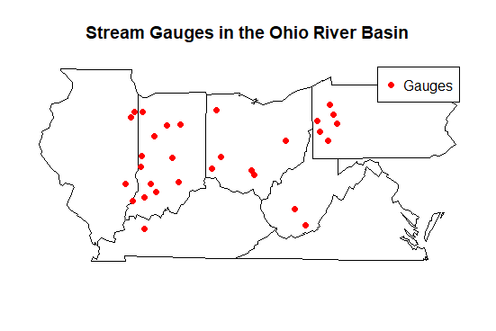
Data
Base Data Characteristics – Streamflow
Extremity Metric – Site Specific Annual Maximum. (The daily time series was converted to a yearly annual maximum time series.)
Series Length – 81 years(1937-2017)
Number of Sites – 30 (drainage area greater than 1450 sq.miles.)
Data Source: USGS, EPA¹
Figure:- Stream Gauges utilized in the Ohio River Basin.
1 - Hirsch, R.M., and De Cicco, L.A., 2015, User guide to Exploration and Graphics for RivEr Trends (EGRET) and dataRetrieval: R packages for hydrologic data (version 2.0, February 2015): U.S. Geological Survey Techniques and Methods book 4, chap. A10, 93 p., http://dx.doi.org/10.3133/tm4A10

Slide 5
Principal Component Wavelet Clustering
Research Question:- What are the characteristic time scales of recurrence, and the associated spatial patterns?
This broad method is divided into two subcategories
1- Space Pattern -Time Frequency
2- Time Frequency – Space Pattern
Principal Component Analysis
Eigenvectors
Spatial Patterns
PC Scores
Temporal Projections
Wavelet
Analysis
Frequency Domain
Cyclical / Acyclical Trends

Slide 6
Space - Time
PCA: Dimension reduction based on Principal Component Analysis on the entire field. (Spatial Patterns)
Based on the cumulative variance explained by the PCs, select an appropriate number of PCs.
Wavelet: For each PC, carry out wavelet analysis. (Temporal Patterns)
Time - Space
Wavelet: Carry out a wavelet analysis at each site. (Temporal Patterns)
Clustering: Based on the wavelet spectrums the sites are hierarchically clustered.
PCA: For each cluster, the 1st PC is extracted. (Spatial Pattern)
Wavelet: The wavelet transform is applied to the 1st PC.

Slide 7
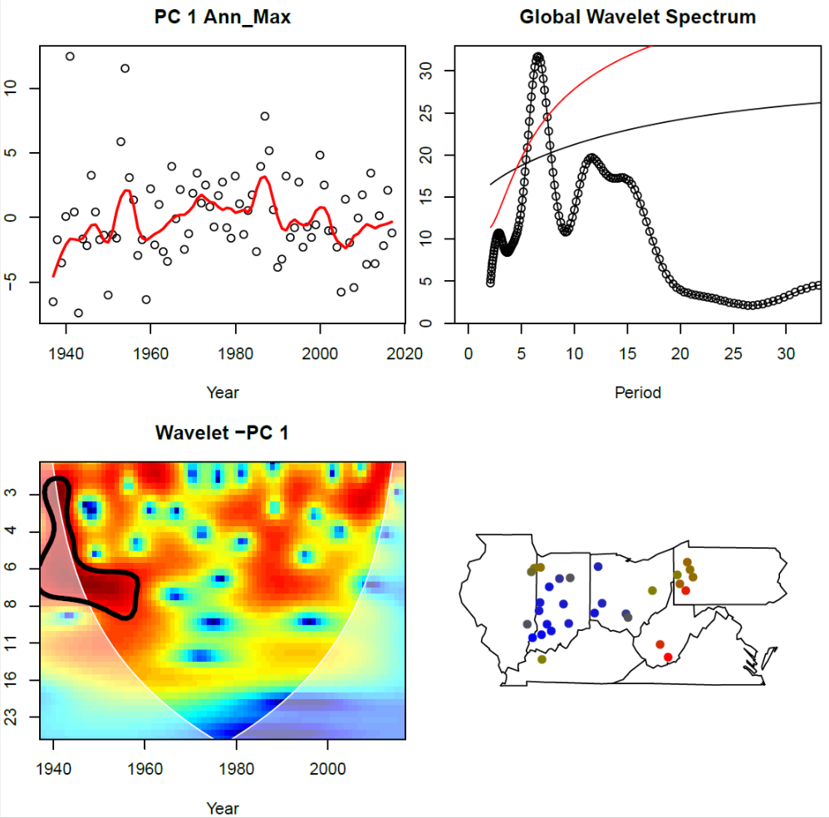
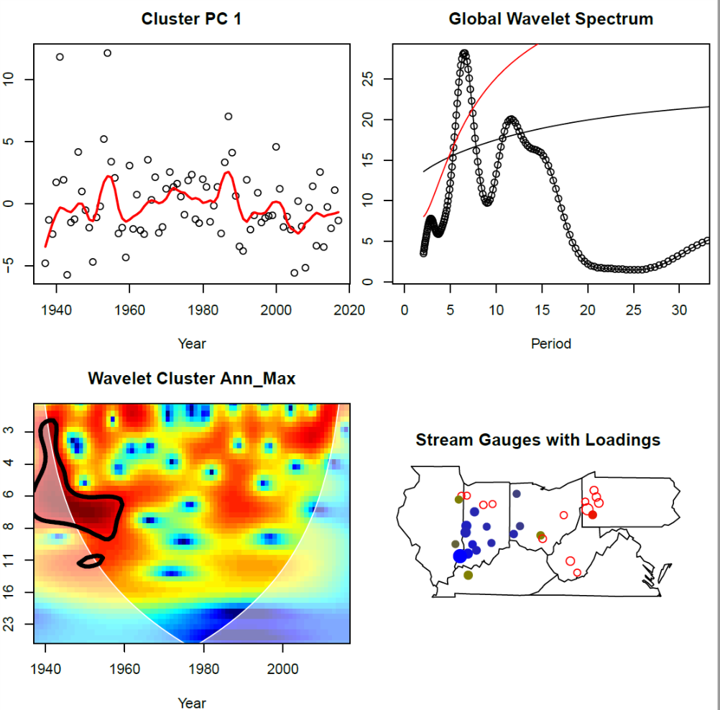
Space - Time
Time-Space
Fig: (top-right) PC with loess fit. (top-left) Global wavelet spectrum. Red and Black line correspond to 90% red and white noise confidence intervals respectively. (bottom-right) Wavelet Power Spectrum. Areas unclosed in the thick black line are significant. (bottom left) Stations with associated absolute value of eigenvectors. Color Scheme – Blue to Red: Highest to Lowest.

Slide 8
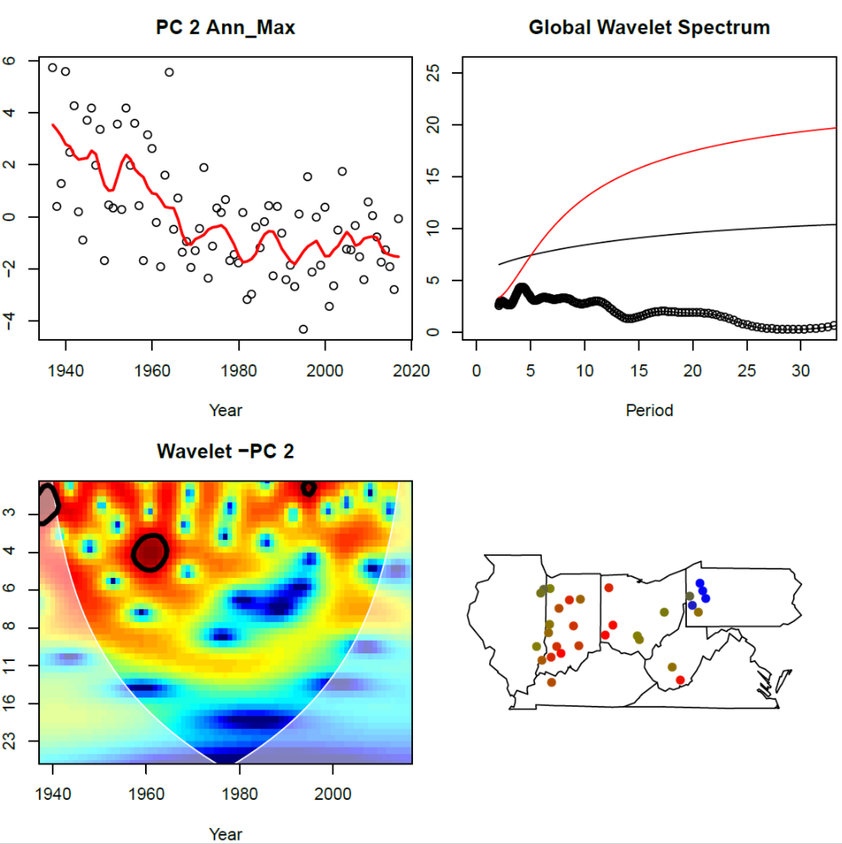
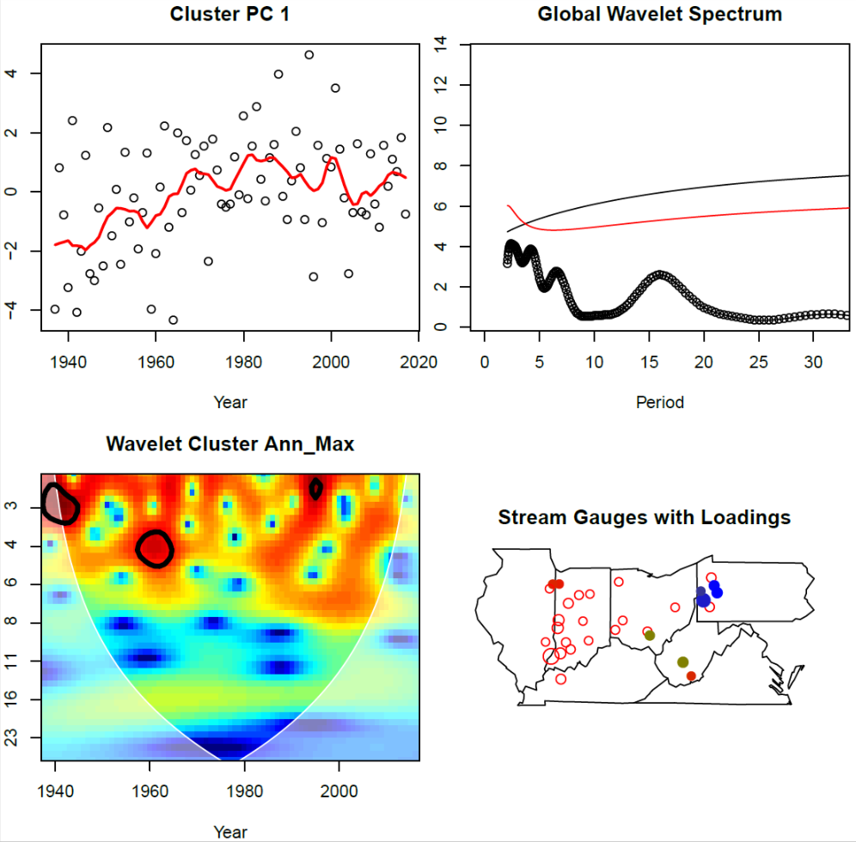
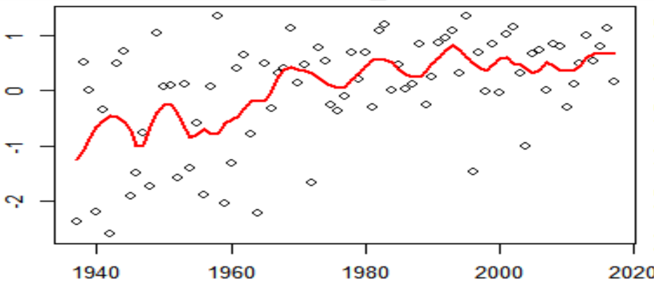
Space - Time
Time - Space
Fig: (top-right) PC with loess fit. (top-left) Global wavelet spectrum. Red and Black line correspond to 90% red and white noise confidence intervals respectively. (bottom-right) Wavelet Power Spectrum. Areas unclosed in the thick black line are significant. (bottom left) Stations with associated absolute value of eigenvectors. Color Scheme – Blue to Red: Highest to Lowest.

Slide 9
PC-SETAR – Multisite Simulations
Research Question: Is there a statistical model that can capture and simulate these low frequency dynamics?
PCA
SETAR
Simulation
Dimension Reduction.
Separation of Signal from the Noise.
The number of PCs is selected by the cumulative variance explained.
Self Exciting Threshold Autoregressive(SETAR) Models.
Has been shown to model much more complex behavior (Tong 1979).
A separate SETAR Model is fit for each PC.
Each SETAR model is simulated (n~1000) times.
For each simulation, the PC’s are used to reconstruct the original data.

Slide 10
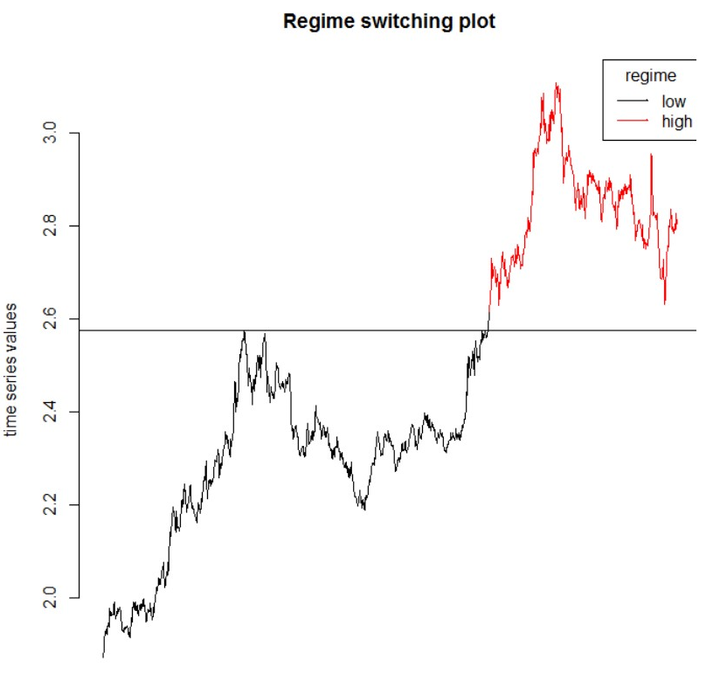

Self Exciting Threshold Autoregressive Models (SETAR)
Self-Exciting Threshold Autoregressive (SETAR) Models, are a subset Threshold Auto-regressive (TAR) models. (Tong, 1989).
Concept of piecewise linearity is used to model much more complex behavior compared to the traditional auto-regressive model.
Example of a SETAR(2,2,3) model.
Figure: Regime Switching Plot¹.
$$y_{t}= \left\{\begin{aligned}&α_{0}^{1}+ α_{1}^{1}∗y_{t−1}+ α_{2}^{1}∗y_{t−2}+ε_{t}^{1} y_{t−1}<threshold value \\ & \\ &α_{0}^{2}+ α_{1}^{2}∗y_{t−1}+ α_{2}^{2}∗y_{t−2}+α_{3}^{2}∗y_{t−3}+ ε_{t}^{2} y_{t−1}>threshold value\end{aligned}\right.$$
1 - Fırat, E. H. (2017). SETAR (self-exciting threshold autoregressive) non-linear currency modelling in EUR/USD, EUR/TRY and USD/TRY parities. Math. Stat., 5, 33-55.

Slide 11
Self Exciting Threshold Autoregressive (SETAR) Models
Name | Embedding Dimension | Lower Regime Dynamics | Upper Regime Dynamics | Threshold Lag | Threshold Value
PC1 | 4 | 4 | 4 | 3 | 0.4894
PC2 | 2 | 1 | 2 | 1 | -0.432
PC3 | 1 | 1 | 1 | 1 | -0.245
Model fit - MLE.
Model Comparison - AIC.

Slide 12
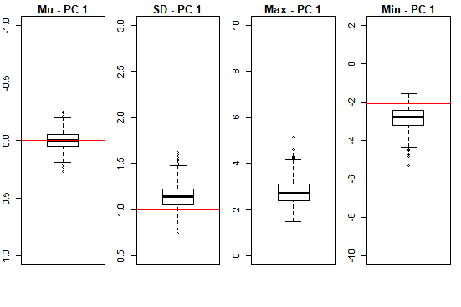
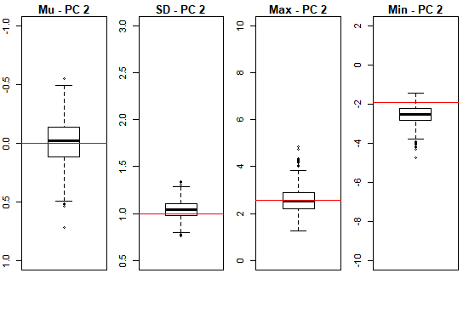
Simulating the PC Moments
Fig 1: Boxplots of Moments for PC-1 (a) Mean (b) Standard Deviation (c) Maximum (d) Minimum. Red line indicates PC value.
Fig 2: Boxplots of Moments for PC-1 (a) Mean (b) Standard Deviation (c) Maximum (d) Minimum. Red line indicates PC value.

Slide 13
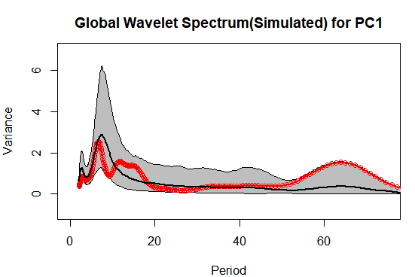
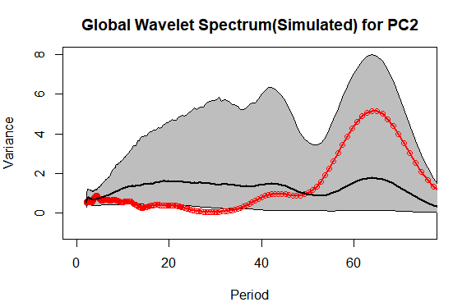
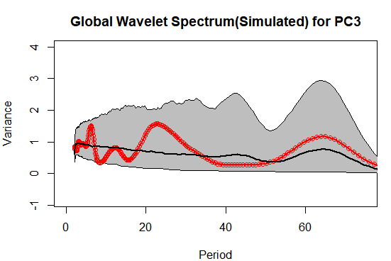
Global Wavelet Spectrum Replication
The PC-SETAR methodology was able to replicate the spectral signature of all three PCs.
Fig: Simulated Global Wavelet Spectrum (a) PC1 (b) PC2 (c) PC3. Shaded Grey Regions are the 5th – 95th percentiles of the simulated spectrum. Thick Black Line –Median of the simulations. Red Line – True Spectrum.

Slide 14
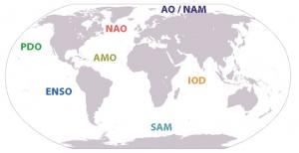
Prediction using Climate Indices
Research Question: Do typical climate indices correlate with and provide a measure of predictability for these extreme flood patterns?
Climate Indices are major sources of global variability over decadal time scales.
Climate Indices³
ENSO – Nino 3.4 – HadISST
PDO – JISAO
NAO – Jones et al.
Seasonality :– Mean FMAM Climatology(current year)
Figure:- Global Climate Indices. Courtesy - UCAR

Slide 15
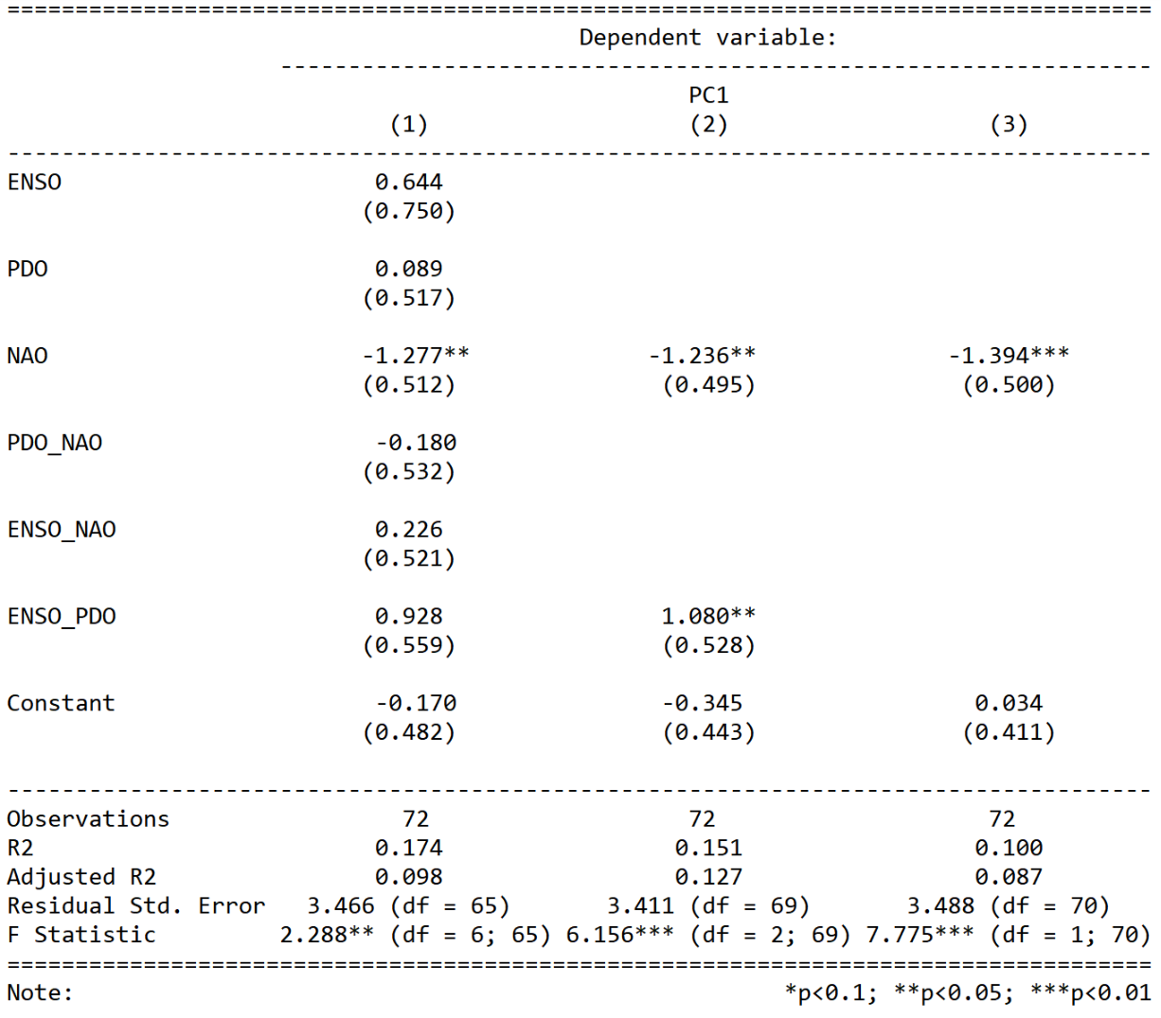
Regression Results
Models Considered:
PC1 ~ ENSO + PDO + NAO + ENSO-PDO + ENSO-NAO + NAO-PDO
PC1 ~ NAO + ENSO-PDO -> Best Fit
PC1 ~ NAO

Slide 16
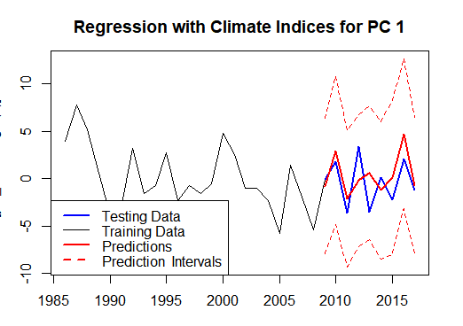
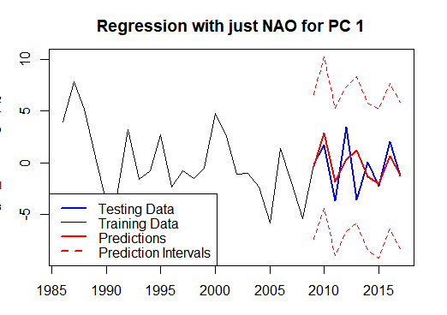
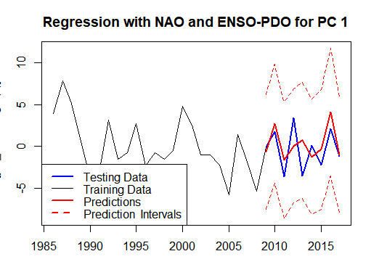
Figure 1: Regression with all climate indices.
Figure 2: Regression with just NAO.
Figure 3: Regression with just NAO and ENSO-PDO.

Slide 17
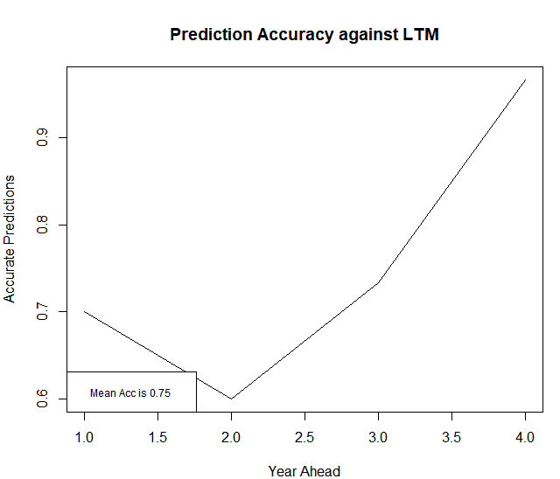
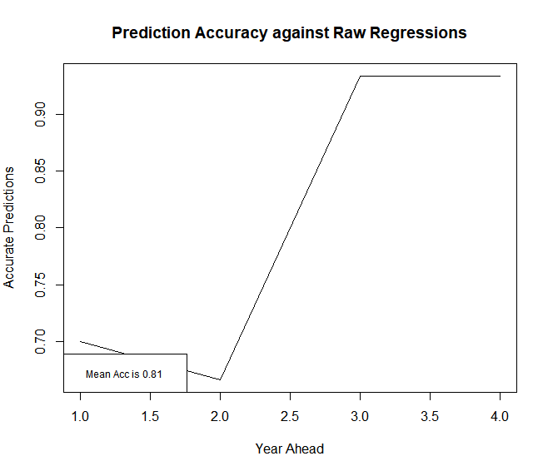
Prediction Skill
Test against Site-Specific Long Term Mean
Test against Site-Specific Regression
Mean Accuracy 75%
Mean Accuracy 81%
Figure :- Prediction skill across the 4 year-horizon against the benchmarks (a) Long Term Mean - LTM (b) Site specific, NAO and ENSO*PDO regressions.

Slide 18
Conclusions
There is evidence of structured inter-annual climate variations and trends in the streamflow extremes for the Ohio River Basin, supporting past analyses using different methods.
The PC-SETAR Approach is successful in simulating the key temporal aspects of this variation, suggesting that simple models that account for inter-annual regime transitions can be useful for simulating persistent wet/dry extreme streamflow conditions with a characteristic recurrences.
More data in the future can be used to update SETAR model parameters to close to loop and capture the dynamics.
NAO and ENSO-PDO interactions are identified as potentially involved in these regime transitions. Increasing climate index predictive skill can be used to predict streamflow extremes.
In future work, we plan to
Leverage the analyses here to provide climate informed multi-year flood risk scenarios
Provide financial risk mitigation and planning strategies that can use these scenarios

Slide 19
THANK YOU

